Slide 1
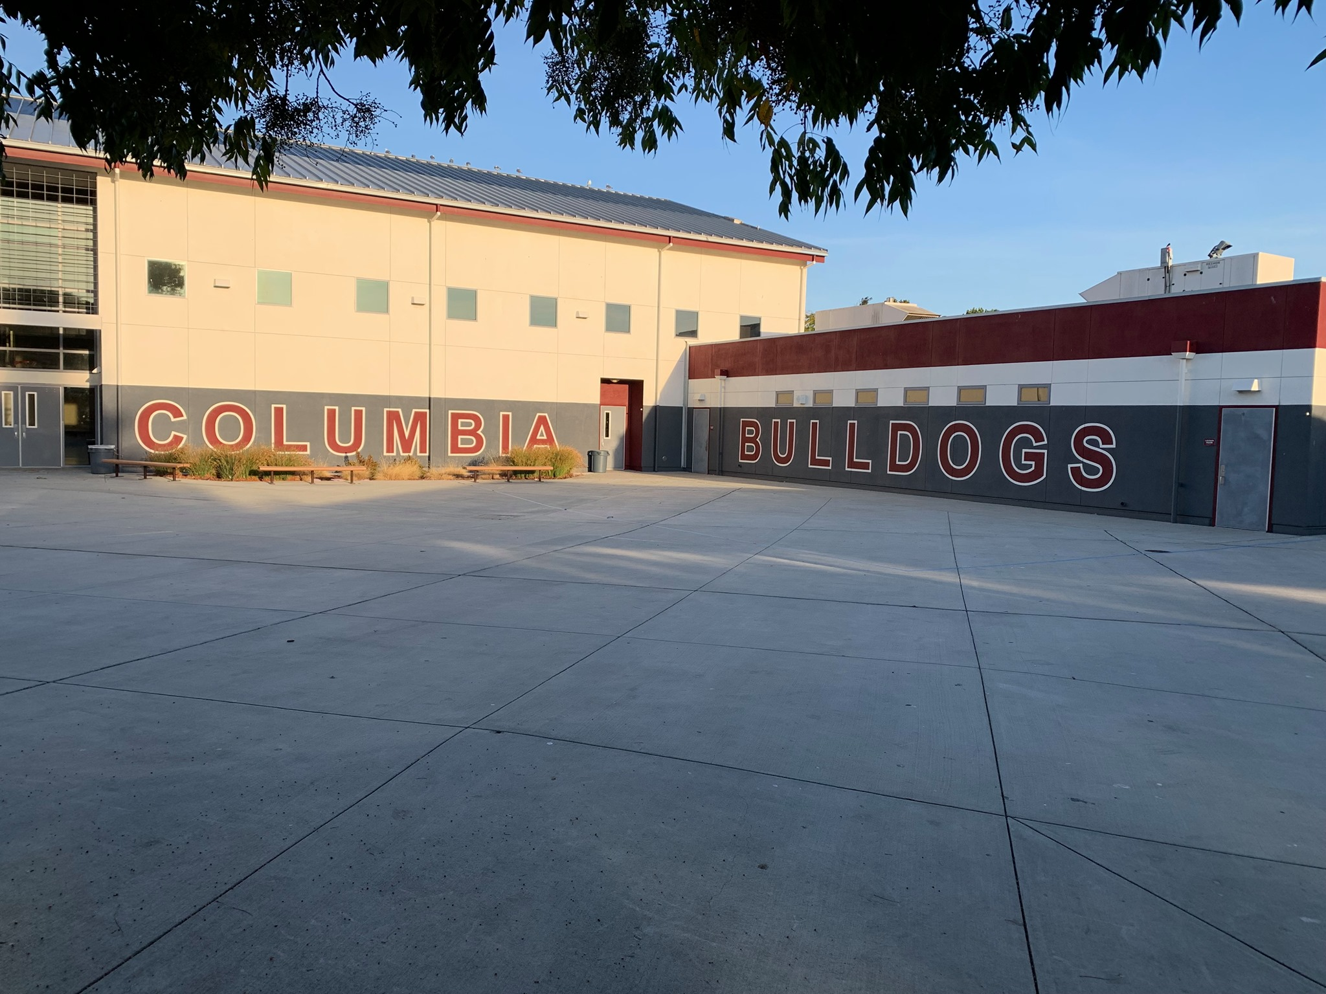
Columbia Middle School
Home of the Bulldogs

Slide 2
Introductions
Daniel Poo, Principal
Jamie Bradley, Assistant Principal
Dr. Vicky Tarumoto, Assistant Principal

Slide 3
Agenda
Core Components:
Rigorous Instruction
SEL
PBIS
Logistics
Bell schedule
Late Start Days
Parent Engagement

Slide 4
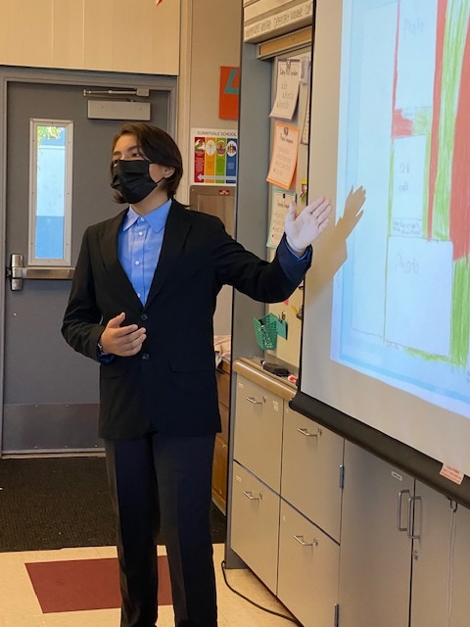
CMS Core Components
Social Emotional Learning (SEL)
Self-awareness, self-management, social awareness, relationship skills, responsible decision making, and leadership.
Safe School Environment (PBIS)
School-wide PBIS is an evidence-based multi-tiered framework. It establishes a social culture and the behavior supports needed to improve social, emotional, behavioral, and academic outcomes for all students.
Strong Instructional Practice (Rigorous Instruction)
Rigorous project-based learning, promoting Critical Thinking, Creativity, Communication, Collaboration, and Civility. (5C’s), problem-solving with real-world application.

Slide 5
Instructional Practice (Curr/Instr/Assess)
High Expectations +
Support Structures
Curriculum
Data Teams
Instruction
CCSS
SBG
NWEA
CFA
dELD
GRR
Warm
Demander
Social Emotional Well Being
School Environment
Clear Procedures + Reinforcement
Asset Building Mindset
Policies
Cultural Competency/
Positive Relationships
Second Step
Counseling
Acknowledge Alliance
Tier 1 – Bulldog Pride
Tier 2-CICO/Counseling
Tier 3–BSP/Case Mgmt.
Notes:
mission and vision

Slide 6
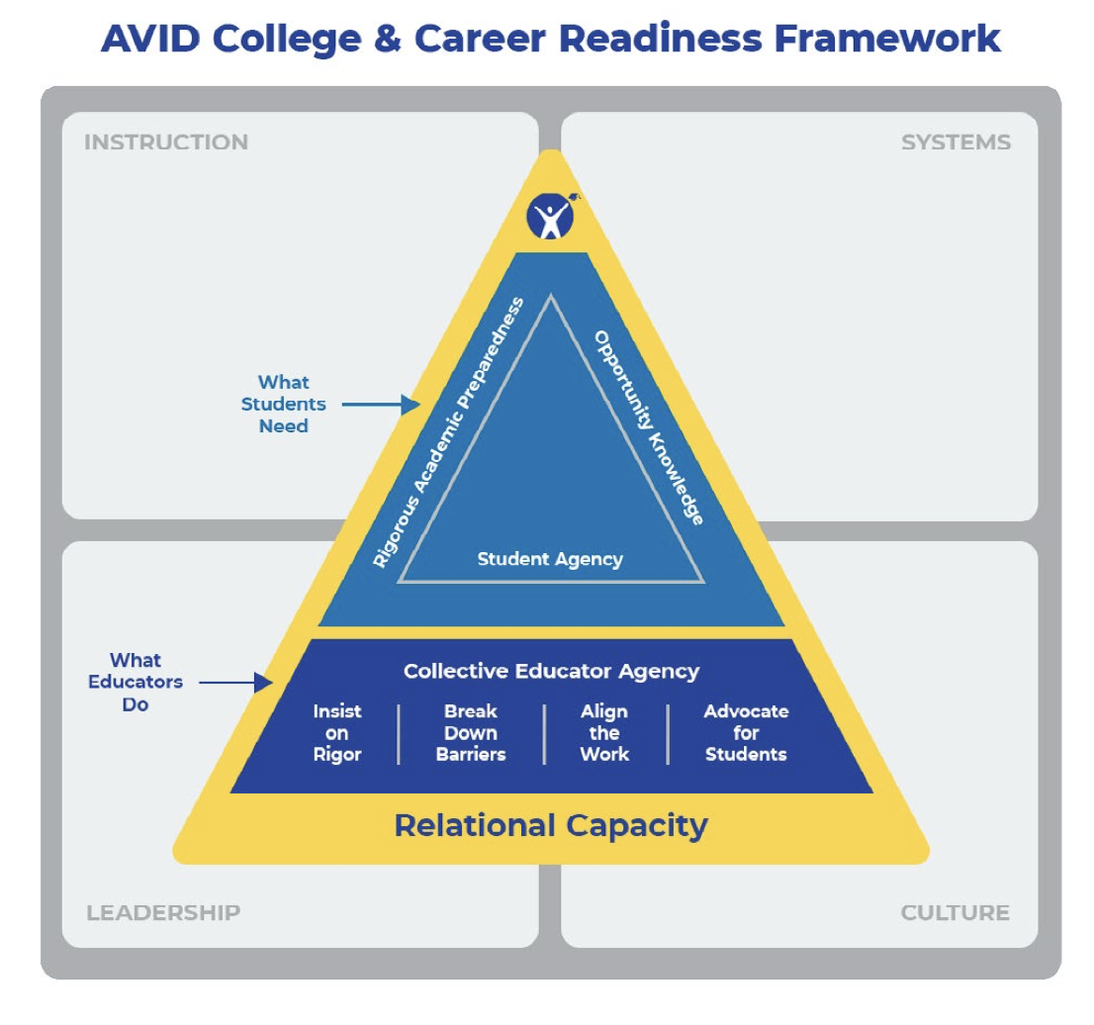
AVID
program
school-wide

Slide 7
Why AVID?
AVID, which stands Advancement Via Individual Determination, is an organization that helps prepare students for college. AVID helps students become more organized by using a planner. It also encourages students to answer higher-level thinking questions and develop college-level writing skills
AVID accelerates students into more rigorous courses. AVID incorporates the intensive support students need to succeed in rigorous courses. AVID uses Socratic methods and study groups that specifically target the needs of the student. AVID is a school-wide initiative, not a school within a school.

Slide 8
Academic Rigor
California Gold Ribbon School
Hoffman Award Winner
Aligning the work
Common Curriculum and Assessments with Sunnyvale Middle
Articulation with Fremont High School
Dual Immersion Program: Juntos 2021
Notes:
8-13 Vicky

Slide 9
Social Emotional
Social Workers: Vicky Salazar & Laura Villanueva
Student Service Center: Individual Counseling
Mental Health Associate: New Position
Zen Room: Emotional Regulation Room

Slide 10
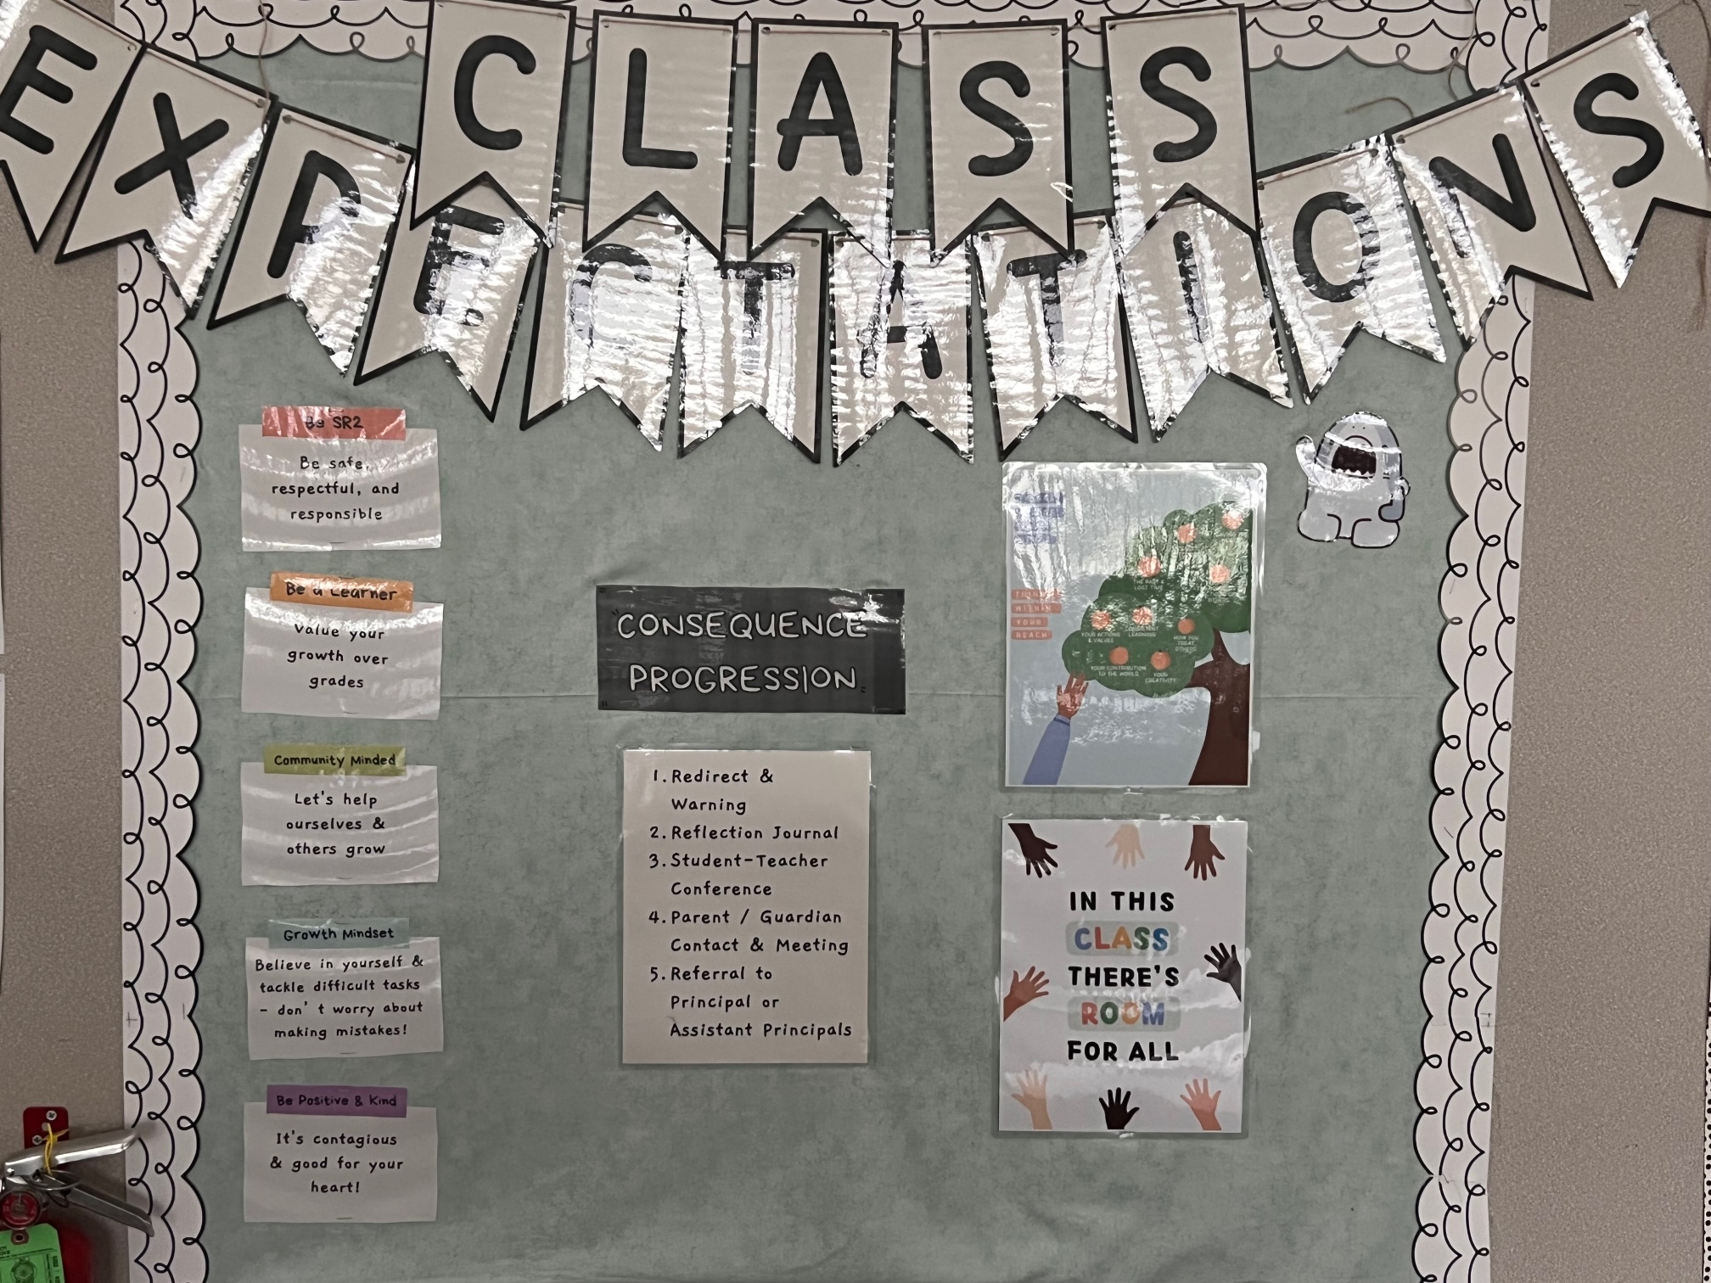
PBIS (Positive Behavior Intervention and Supports)
Social-Emotional Learning
What does it look like?:
Schoolwide Expectations: Bulldog PRIDE
PRIDE Tickets
PRIDE Store
Bulldog of the Month
Results:
SCCOE PBIS “Spotlight School”
Reduction in referrals and suspensions
Below National 25%

Slide 11
What is Bulldog PRIDE?
PRIDE is our new school-wide behavior agreement. Each letter stands for a characteristic that we want to represent.
P repared
R espectful
I ntegrity
D etermined
E mpathy

Slide 12
Bulldog PRIDE Mantra
I am Prepared. I bring all materials to class and am ready to learn.
I am Respectful. I value myself and my community.
I will act with Integrity. I represent my values, even with no one else around.
I am Determined. I will succeed at whatever I choose to do.
I will show Empathy. I am considerate of others’ feelings.
I am a Bulldog and I show PRIDE.

Slide 13
Logistics

Slide 14
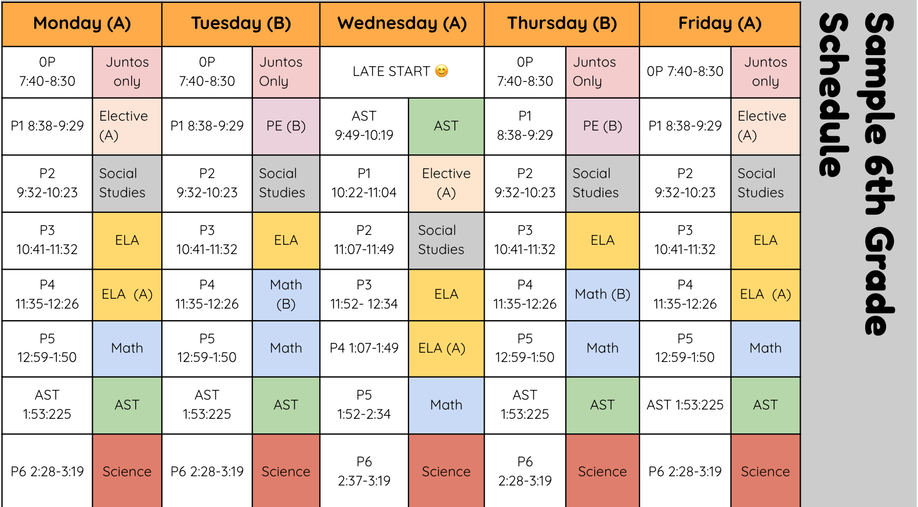

Slide 15
Late Start Days
We will offer Late Start Care but Space is limited, but we have more spaces because we will be partnering with the CNC.
Google Form will be sent out to families during the first week of school.
School starts at 9:49am on Wednesdays
Notes:
21-25 Vicky

Slide 16
Student Schedule
Student Schedule – 6th
1) Elective/PE – Teacher C and D
2) Social Studies – Teacher A
3) English – Teacher A
4) Eng/Math – Teacher A and Teacher B
5) Math – Teacher B
6) Science – Teacher B
AST- Teacher to be determined
(AST: Academic Support Time)

Slide 17
Student Schedule
Student Schedule – Juntos
0) Spanish Language Arts- Teacher E
1) Elective/PE – Teacher C and D
2) Social Studies – Teacher A
3) English – Teacher A
4) Eng/Math – Teacher A and Teacher B
5) Math – Teacher B
6) Science – Teacher B
AST- Teacher to be determined
(AST: Academic Support Time)

Slide 18
Student Schedule
Bell Schedule
A & B Day rotations (only for 6th Grade)
Applies to 1st, 2nd, 4th periods
Weekly Rotations:
A,B,A,B,A
B,A,B,A,B

Slide 19
Student Schedule
AST
AST stands for Academic Support Time
AST is time built into the school day dedicated to helping students develop strong academic and study habits
Students will complete assignments, collaborate with peers, check their grades and email, set weekly SMART goals, complete organization checks, check in with their AST Teacher, participate in community building activities, and receive additional academic support
Students will also work on developing their socioemotional skills through various lessons and activities

Slide 20
Physical Education
CMS will sell PE Clothes during your student’s PE classes. Students may purchase a PE uniform (shirt/shorts) for $25.
Students may also use plain black short and a plain grey shirt.
No sweaters or hoodies with zippers (safety concern)

Slide 21
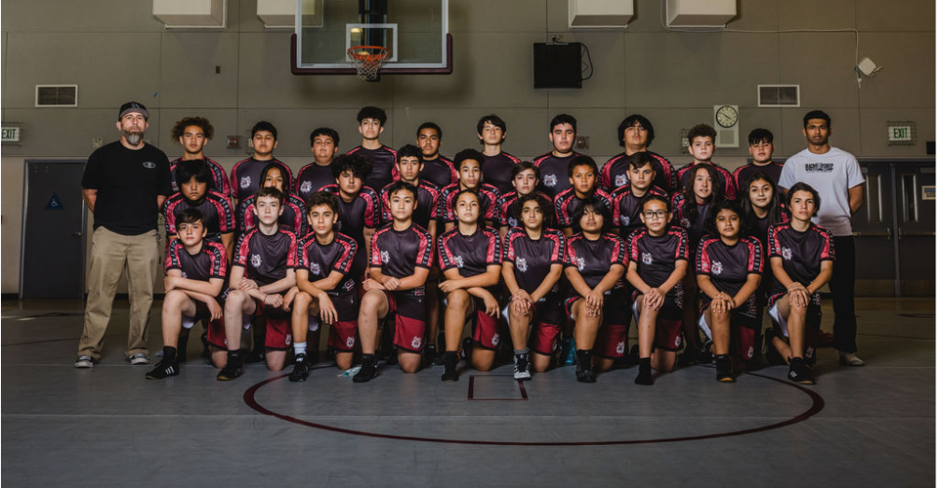
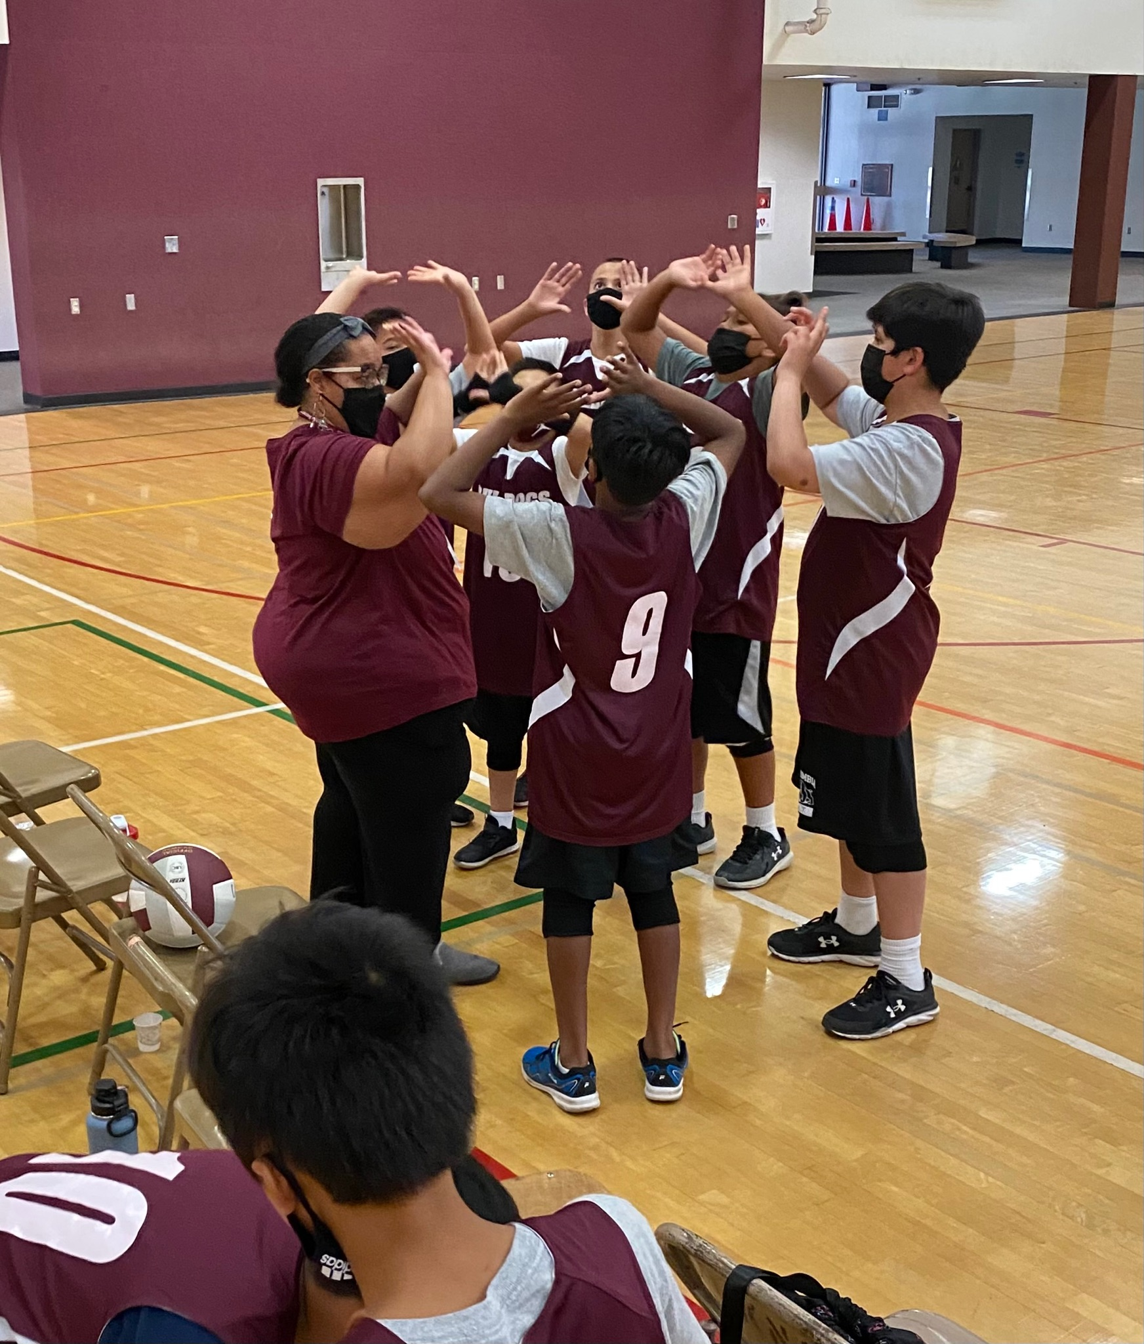
Extra Curricular
Extra-Curricular Past Offerings
Athletics
Cross Country
Wrestling
Softball
Track
Basketball
Soccer
Volleyball
Afterschool
CommunKnitting
Magic the Gathering
Tech Deck Club
Starting Arts (School Play)

Slide 22
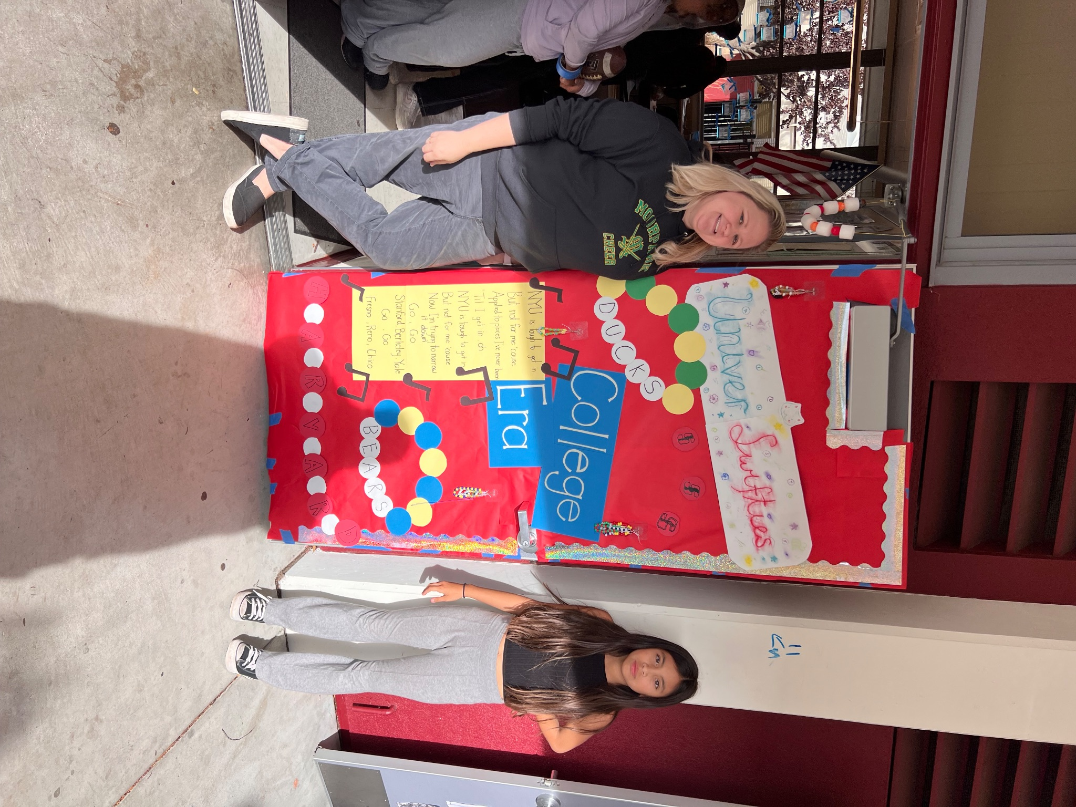
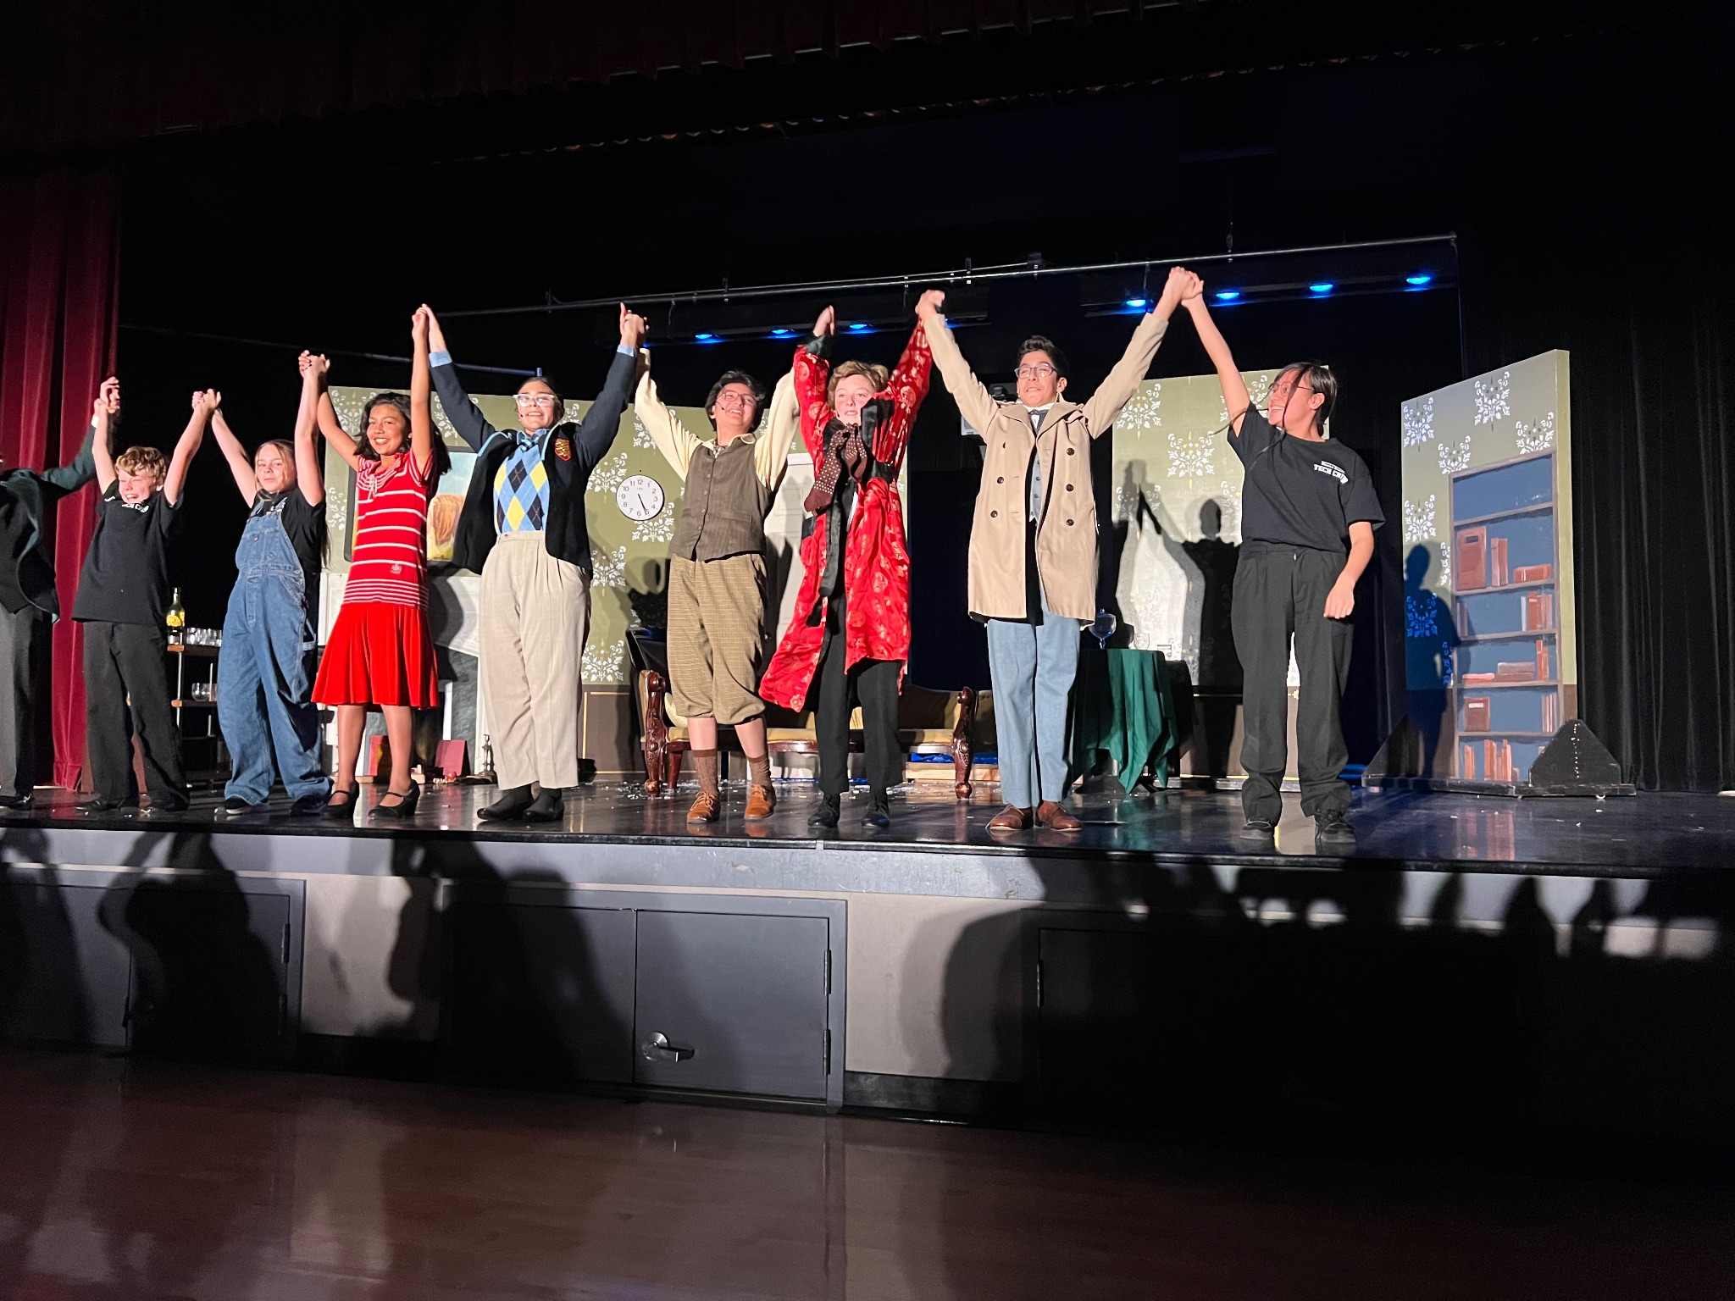
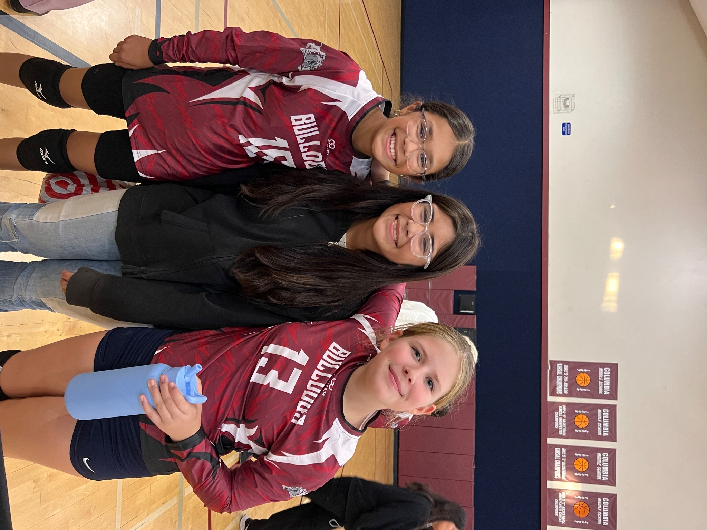
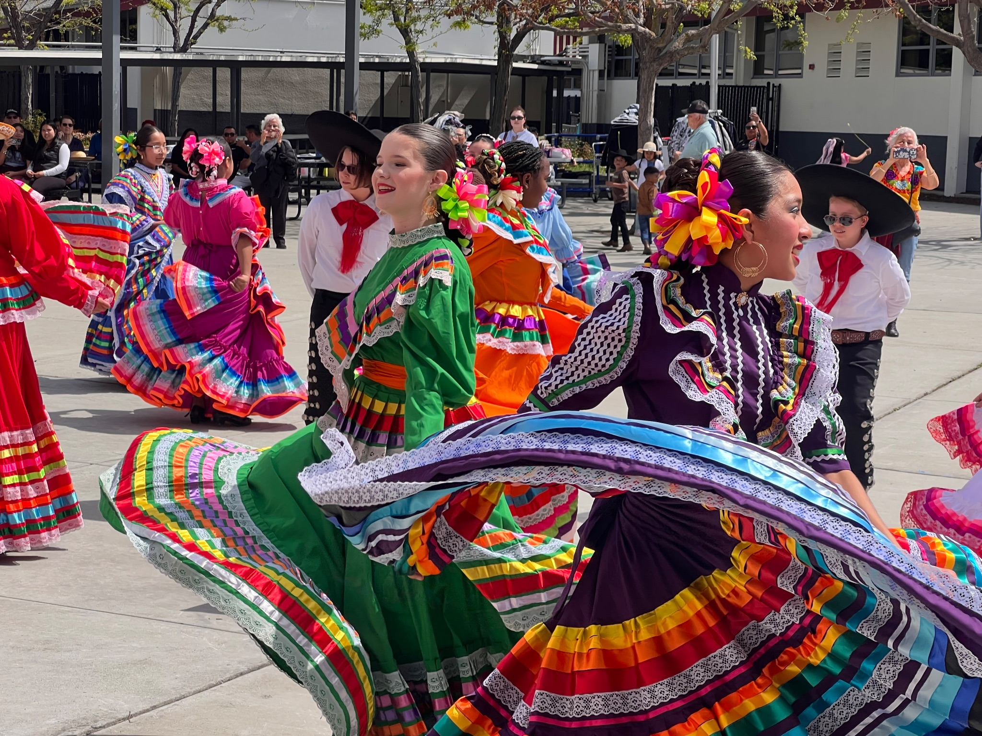

Slide 23
Parent Engagement

Slide 24
Partnerships
CNC – Columbia Neighborhood Center
Health Clinic
Parent Education
Digital Literacy
Programs for Adults and Youth
(Yoga/Zumba/Fitness, Tax Prep, Covered California)

Slide 25
Family Resource Center
Resources to community information on clinics and events
District and School Forms available
Access to computer and internet
Parent Liaison Coordinator
ELAC (English Language Advisory Committee) meetings
PTSA (Parent Teacher Student Association meetings)

Slide 26
Parent Volunteer Opportunities
Would you like to volunteer on campus?
Provide us with a current negative TB test
Would you like to chaperone or drive students?
Need to be fingerprint cleared in addition to the current negative TB test
Questions about next steps?
Roxana Portillo 408-822-5247 x2064 (CMS)
Vanessa Escobar 408-522-8200 x1027 (DO)

Slide 27
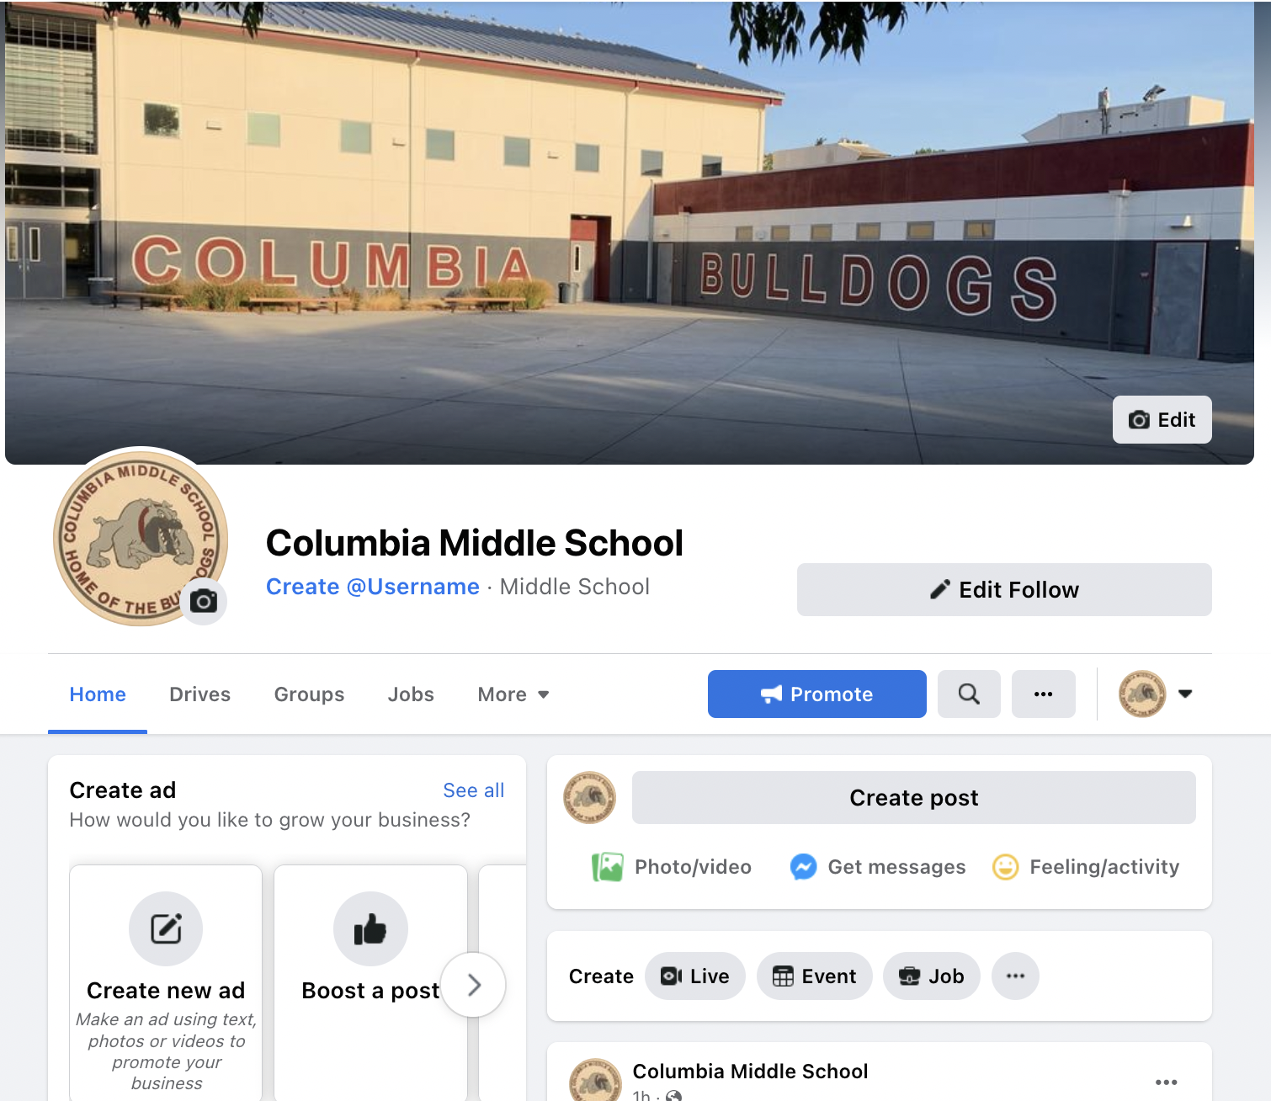
What is the application process?
Follow us on Facebook & Instagram @cmsbulldogs739
https://www.facebook.com/Columbia-Middle-School-104662511979806/

Slide 28
Questions
What questions do you have for us?
Mr. Poo**
Daniel.Poo@sesd.org
Mr. Bradley
Jamie.Bradley@sesd.org
Dra. Tarumoto**
Victoria.Tarumoto@sesd.org
** bilingue

